Slide 1


ACID Properties in Databases

Slide 2

Introduction to Transactions
Understanding Database Transactions Basics
Definition
Importance
Example
A database transaction is a sequence of operations performed as a single logical unit of work, ensuring data integrity and consistency within the database.
Transactions are crucial for maintaining data accuracy and reliability, preventing errors and inconsistencies during operations such as updates, deletions, or insertions in the database.
For instance, in a bank transfer scenario, both the debit from one account and the credit to another must succeed together, or neither should occur to maintain balance integrity.

Slide 3
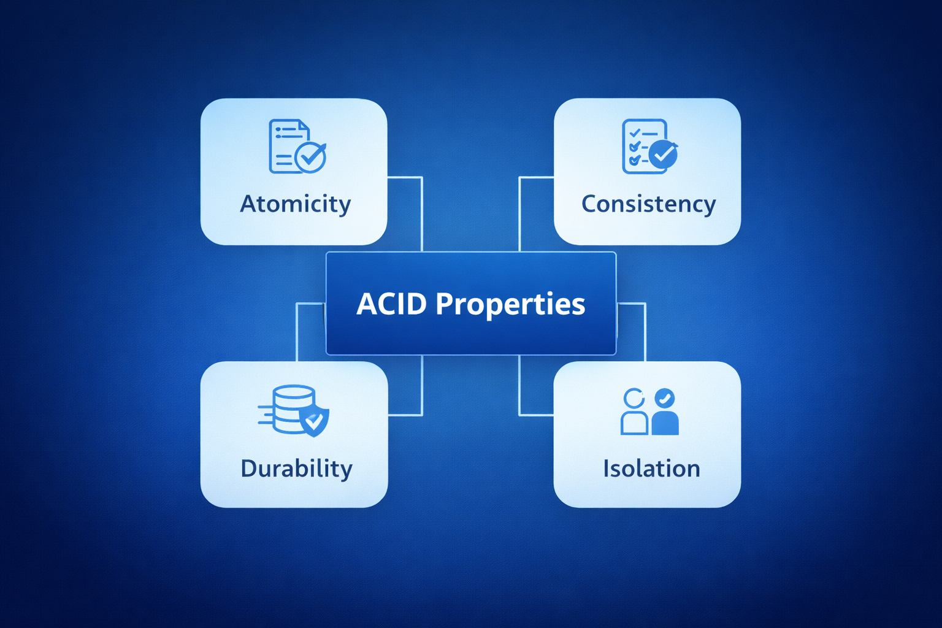
Understanding ACID Properties
ACID properties ensure that database transactions are processed reliably. They include Atomicity, Consistency, Isolation, and Durability, which are essential for maintaining integrity in relational databases.
Used in relational databases like:
MySQL
PostgreSQL
Oracle Database

Slide 4
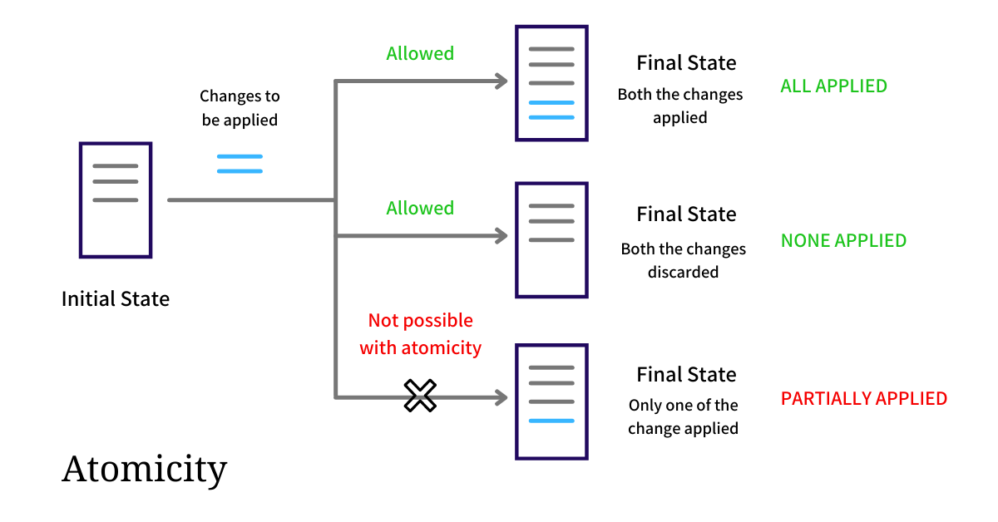
Atomicity: All or Nothing
Atomicity ensures that a database transaction is treated as a single, indivisible unit - either all operations are completed successfully, or none of them are applied.
Key Points:
Ensures complete success or complete failure
If any step fails → the entire transaction is rolled back
Prevents partial updates in the database
Maintains data integrity
Uses COMMIT (save) and ROLLBACK (undo)

Slide 5
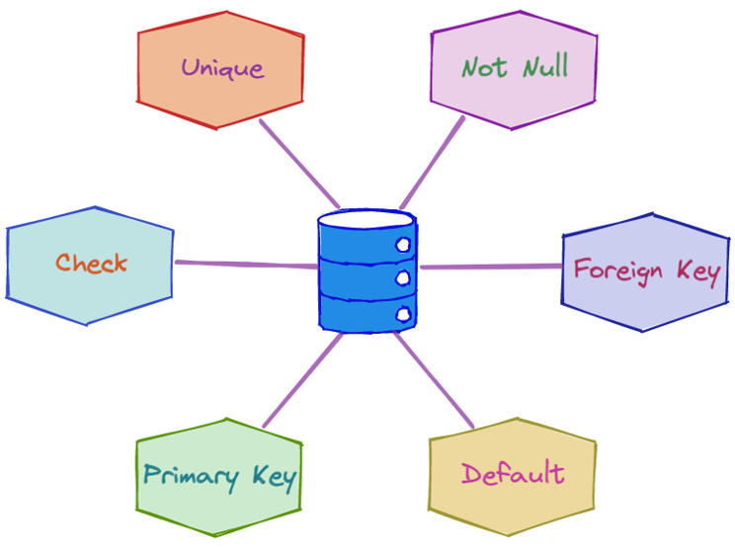
Consistency in Database Management
Consistency ensures that a transaction brings the database from one valid state to another valid state, following all defined rules, constraints, and integrity conditions.
Key Points:
Database must follow defined rules (constraints)
Enforces Primary Key constraints (no duplicate or NULL values)
Maintains Foreign Key relationships (referential integrity)
Ensures correct data types (e.g., integer, date, string)
Follows defined business rules (e.g., account balance cannot be negative)
Prevents invalid or corrupted data

Slide 6
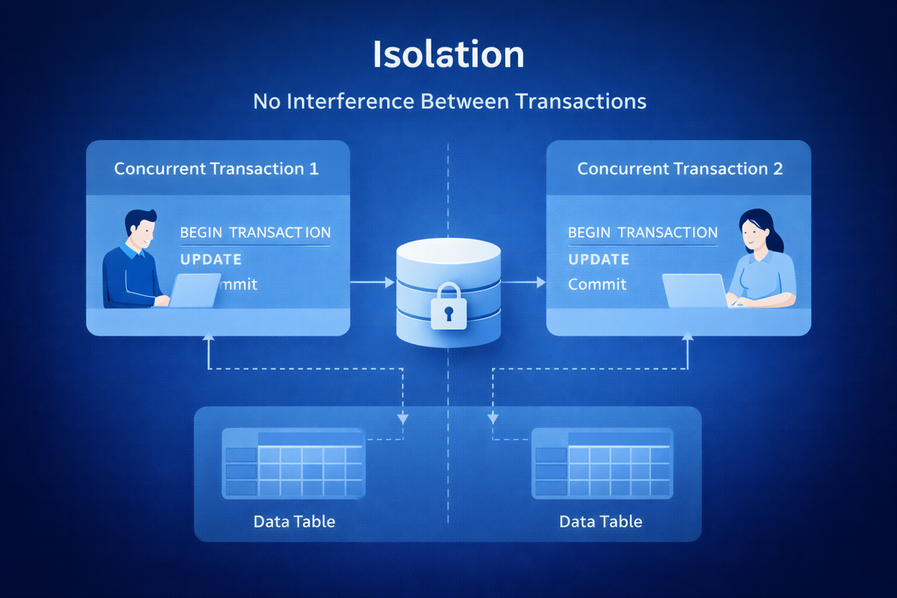
Isolation in Database Transactions
Isolation ensures that multiple transactions executing at the same time do not interfere with each other, and each transaction behaves as if it is running alone.
Key Points:
Multiple transactions can run simultaneously
Transactions should not see each other’s uncommitted data
Prevents data conflicts and inconsistencies
Ensures correct results in concurrent environments

Slide 7
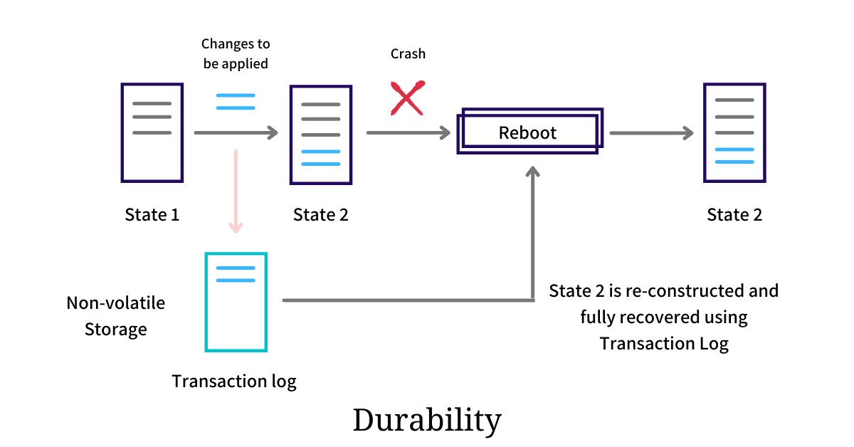
Ensuring Data Durability
Durability guarantees that once a transaction is committed, its changes are permanently stored in the database, even in case of system failure.
Once committed → permanently saved
Survives:
Power failure
System crash
Hardware failure
Uses:
Write-Ahead Logging (WAL)
Transaction logs
Backup & recovery mechanisms
Ensures long-term data reliability

Slide 8
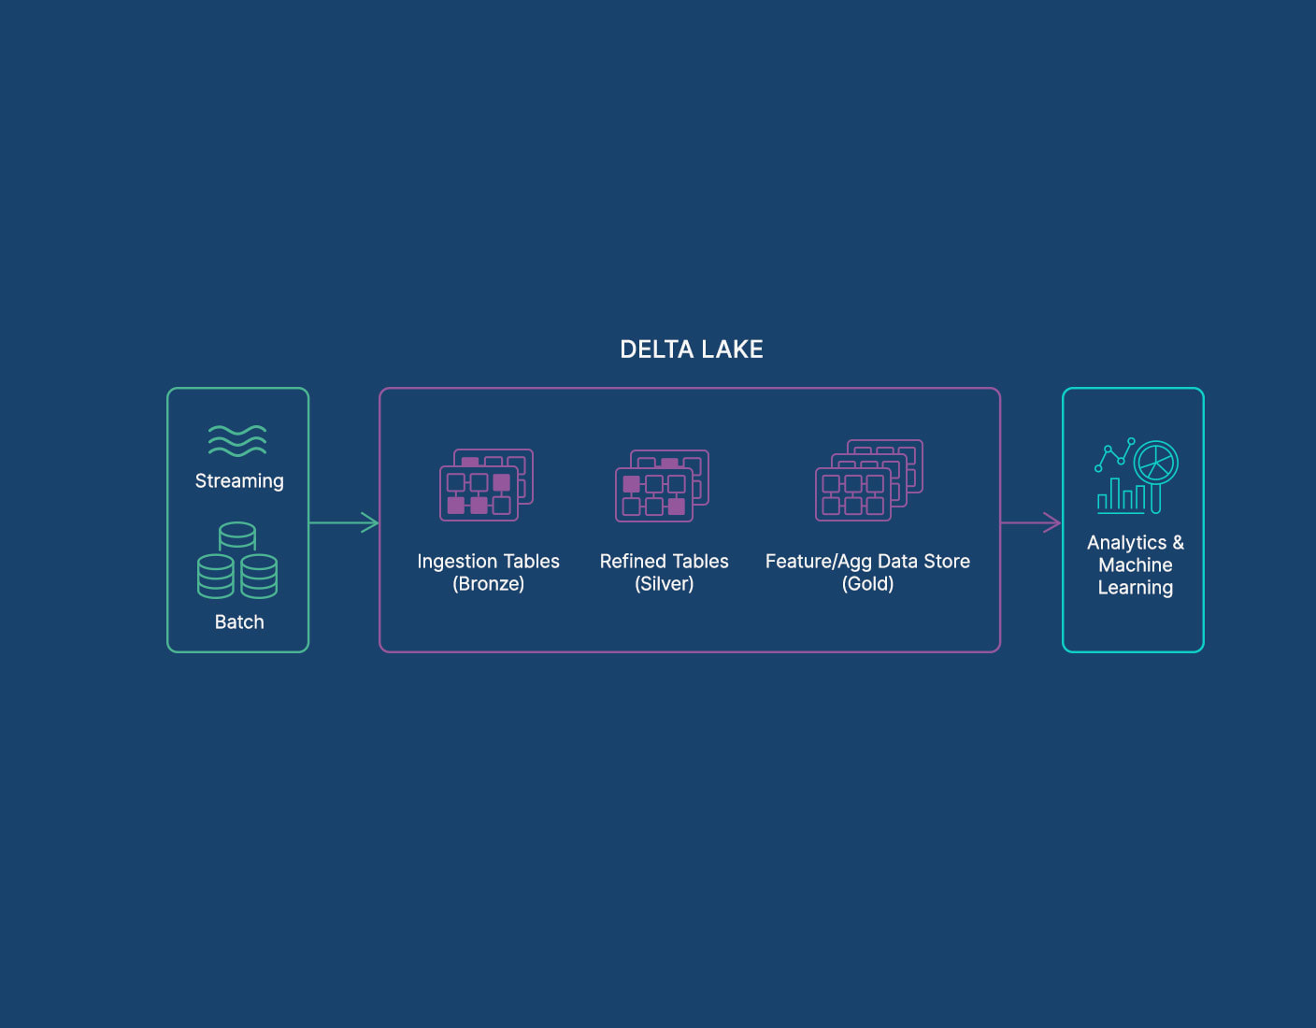
ACID in Modern Data Engineering
ACID properties are no longer limited to traditional relational databases - modern big data platforms now support ACID to ensure reliability at scale.
Traditional relational databases provide strong ACID guarantees
Modern big data systems also support ACID transactions
Technologies enabling ACID in data engineering:
Delta Lake – Adds ACID transactions to data lakes
Apache Spark – Processes large-scale distributed data
Databricks – Unified analytics platform supporting ACID data lakes
Enables reliable, scalable, and trustworthy data lakes
Prevents data corruption in distributed environments

Slide 9
THANK YOU

